Slide 1
Razor Clamming
in Washington State

Slide 2
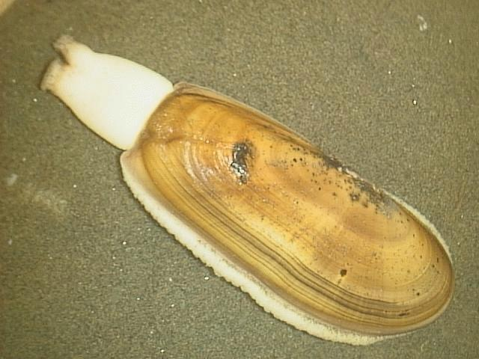
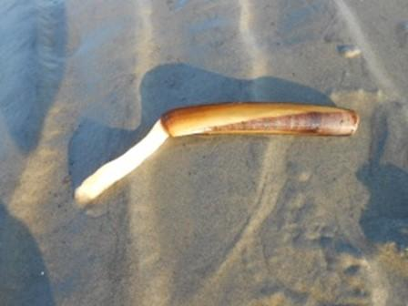
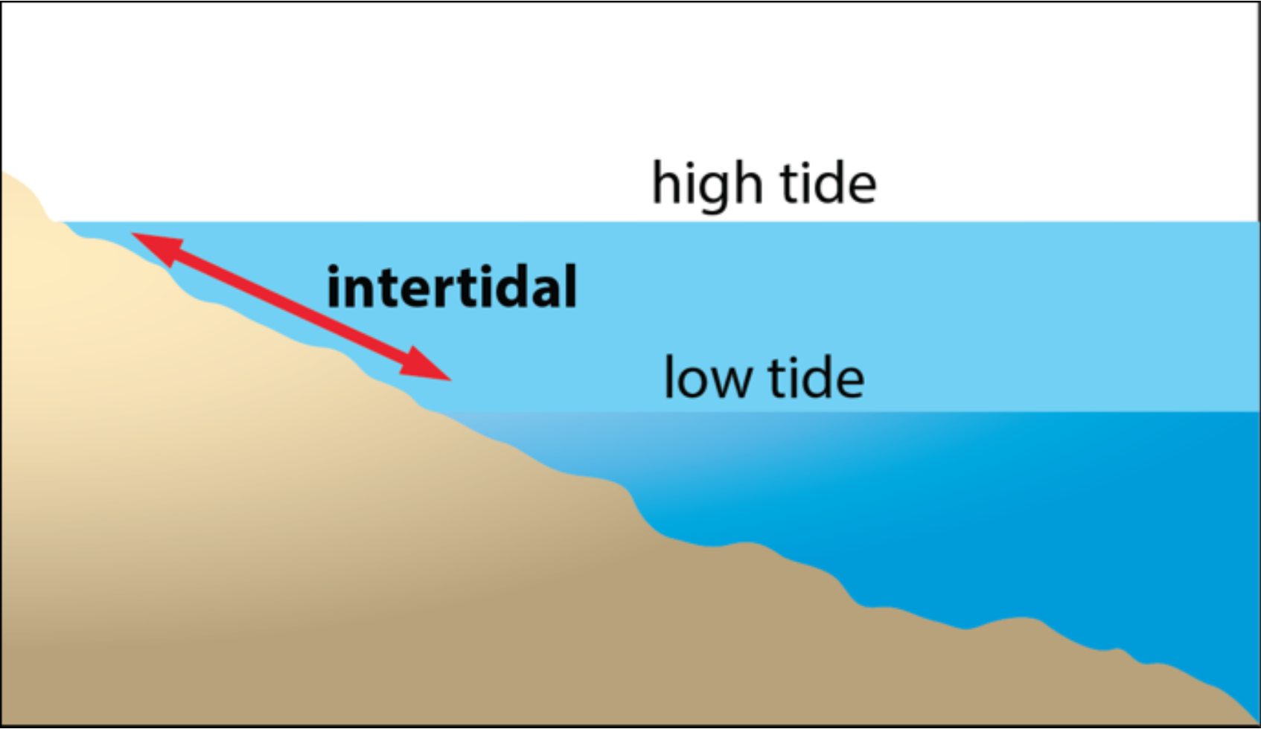
What is Razor Clam?
Scientific name - Siliqua patula
Marine bivalve
Only found along America Pacific West Coast as far as Alaska to Pismo Beach, CA.
Can be 3-11 inches in length.
Lives on sandy beaches’ intertidal zone.
Historically important food source for Native American tribes along the coast.
Not to be confused with Atlantic Razor clam !!

Slide 3
Why is Razor clam?
01
Delicious
02
Fun recreational activity exclusive to PNW & Alaska
03
Makes for a good day trip
04
Expensive if bought from market
Ironically, naturally sweet!
Family-centric activity that attract almost every demographic
See the WA coast, coastal towns, do other shellfish activities like crabbing, fishing, other clams!
Can go as high as $41.99/lb**
**https://www.goldbelly.com/restaurants/pike-place-fish-market/razor-clam-meat-by-the-pound

Slide 4
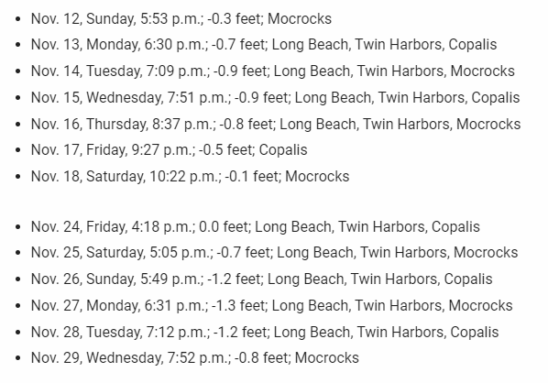
When is Razor clam?
Season typically starts Early Fall to Early Spring depends on clam population and domoic acid levels.
Previous season (2023) went from late September to early April!
Dates open depend on domoic acid level at each beach
Tests are done every week and approvals happen 1-2 days before tentative scheduled openings.
Each opening typically goes on for 4-6 days.
Typically, there’s an opening period every 2 weeks
Population samples collected by WDFW before each season to determine season limits
PM low tides

Slide 5
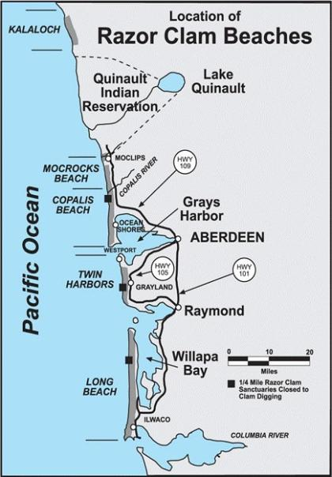
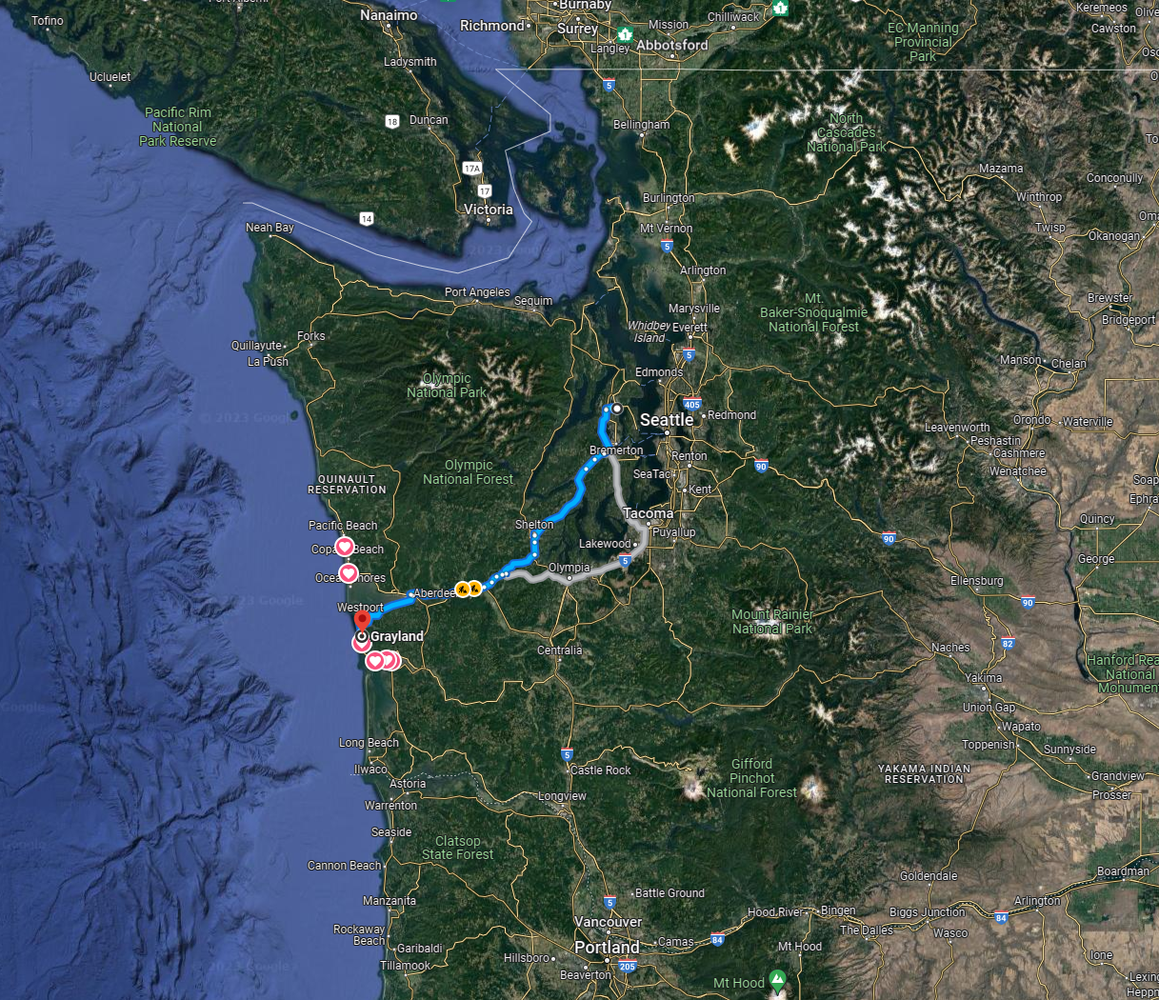
Where is Razor clam?
~ 2.5 hours from Seattle or Keyport office
Washington Department of Fish and Wildlife

Slide 6
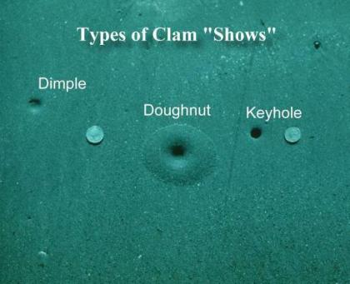
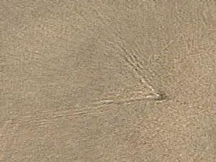
Clam “shows”
Close to the surf

Slide 7
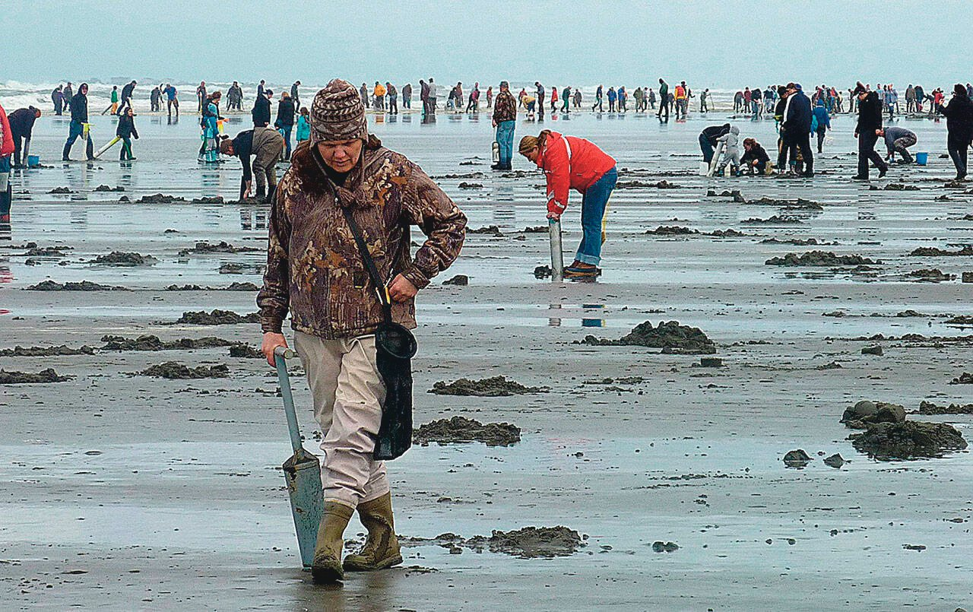
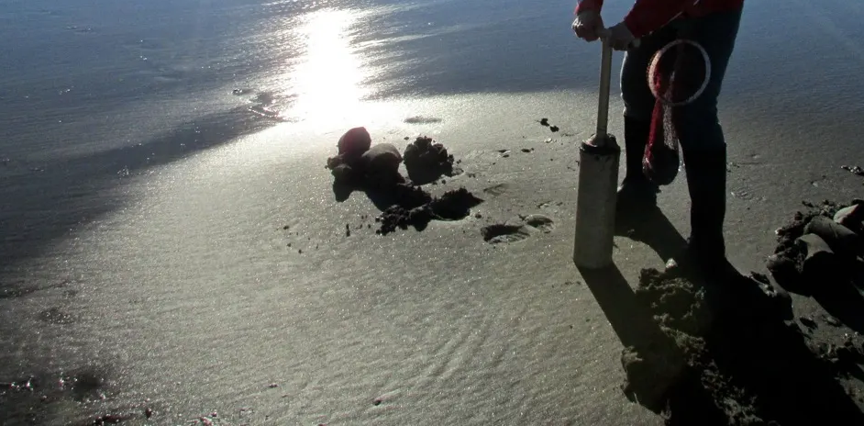
Finding Clam “shows” tips
Closer to surf = more likely to be clam instead of shrimps holes & bigger clams
Closer to surf = hard to find shows as water “flattens” all the holes
Closer to surf = easier to dig because water makes pushing gun into the sand easier
Stomp the ground with feet or clam gun to create vibrations, forcing the clams to start digging and create holes.
Holes are created because they spit out sands as they dig down. Bivalve!
Since WA has the west coast and the sun sets in the same direction, stand facing the ocean, use sunlight reflection on the sand to spot shows
Can be helpful to dig near other diggers to find easy shows
Ask other diggers for help

Slide 8
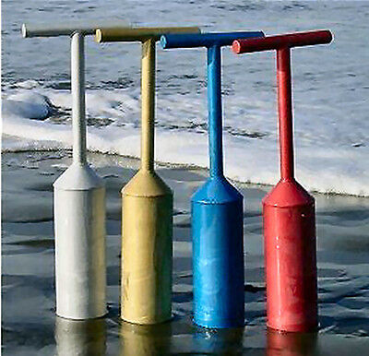
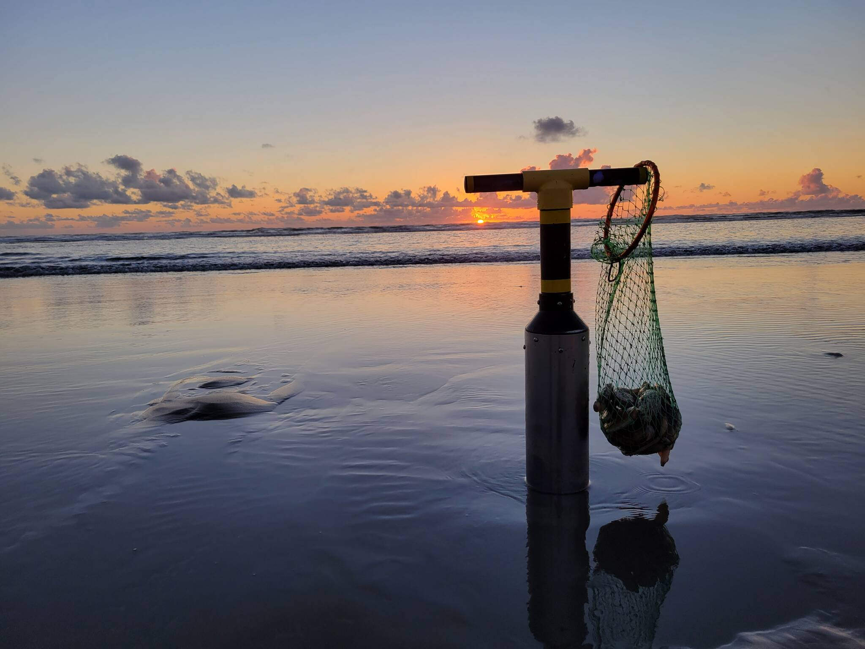
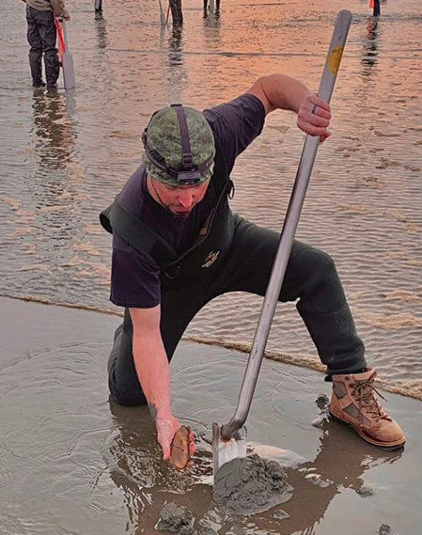
How to Razor clam?
Clam Gun
Shovel
Easier and more friendly for beginners
Less “hands on” / “dirty” method
More “stylish” for some
—--------------------------
A workout!
Back pain if not done correctly (just like weight lifting)
$ to buy. $30-50 for a cheap gun that will kill your back. $200-230 for one that won’t hurt your back.
Most efficient for “pro” & experienced diggers
Cheaper
Good old trusty shovel
Makes you look like a “BA” word
—--------------------------
Cheaper
Less physical but more hands on / dirty
Harder if waves are crashing in
https://theclaminator.com/products/murff-s-claminator%E2%84%A2-stainless-steel-clam-shovels

Slide 9
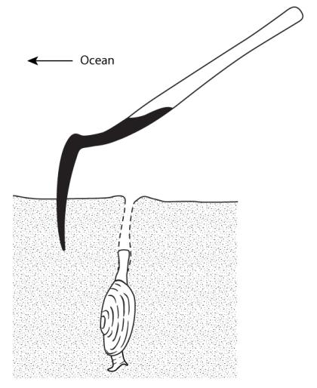
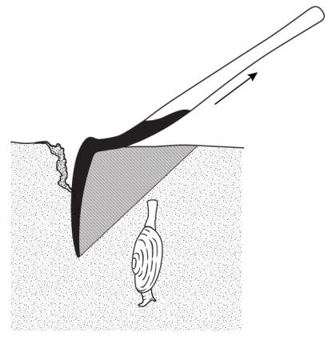
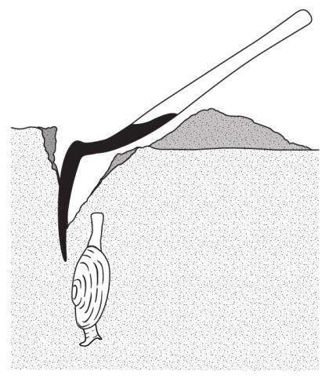
Shovel
https://wdfw.wa.gov/fishing/basics/digging-razor-clams
1. Place the shovel blade 4 - 6" seaward of the clam show. The handle should be pointed toward the sand dunes.
2. Use your body weight to push the shovel vertically into the sand while you drop to one knee.
3. Remove sand by lifting the shovel upward and forward. Repeat until you can reach the clam’s shell with your hand.

Slide 10
Shovel
The Washington Department of Fishing & Wildlife
https://www.youtube.com/watch?v=RBM9b5r6rMQ

Slide 11
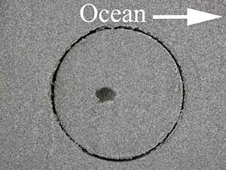
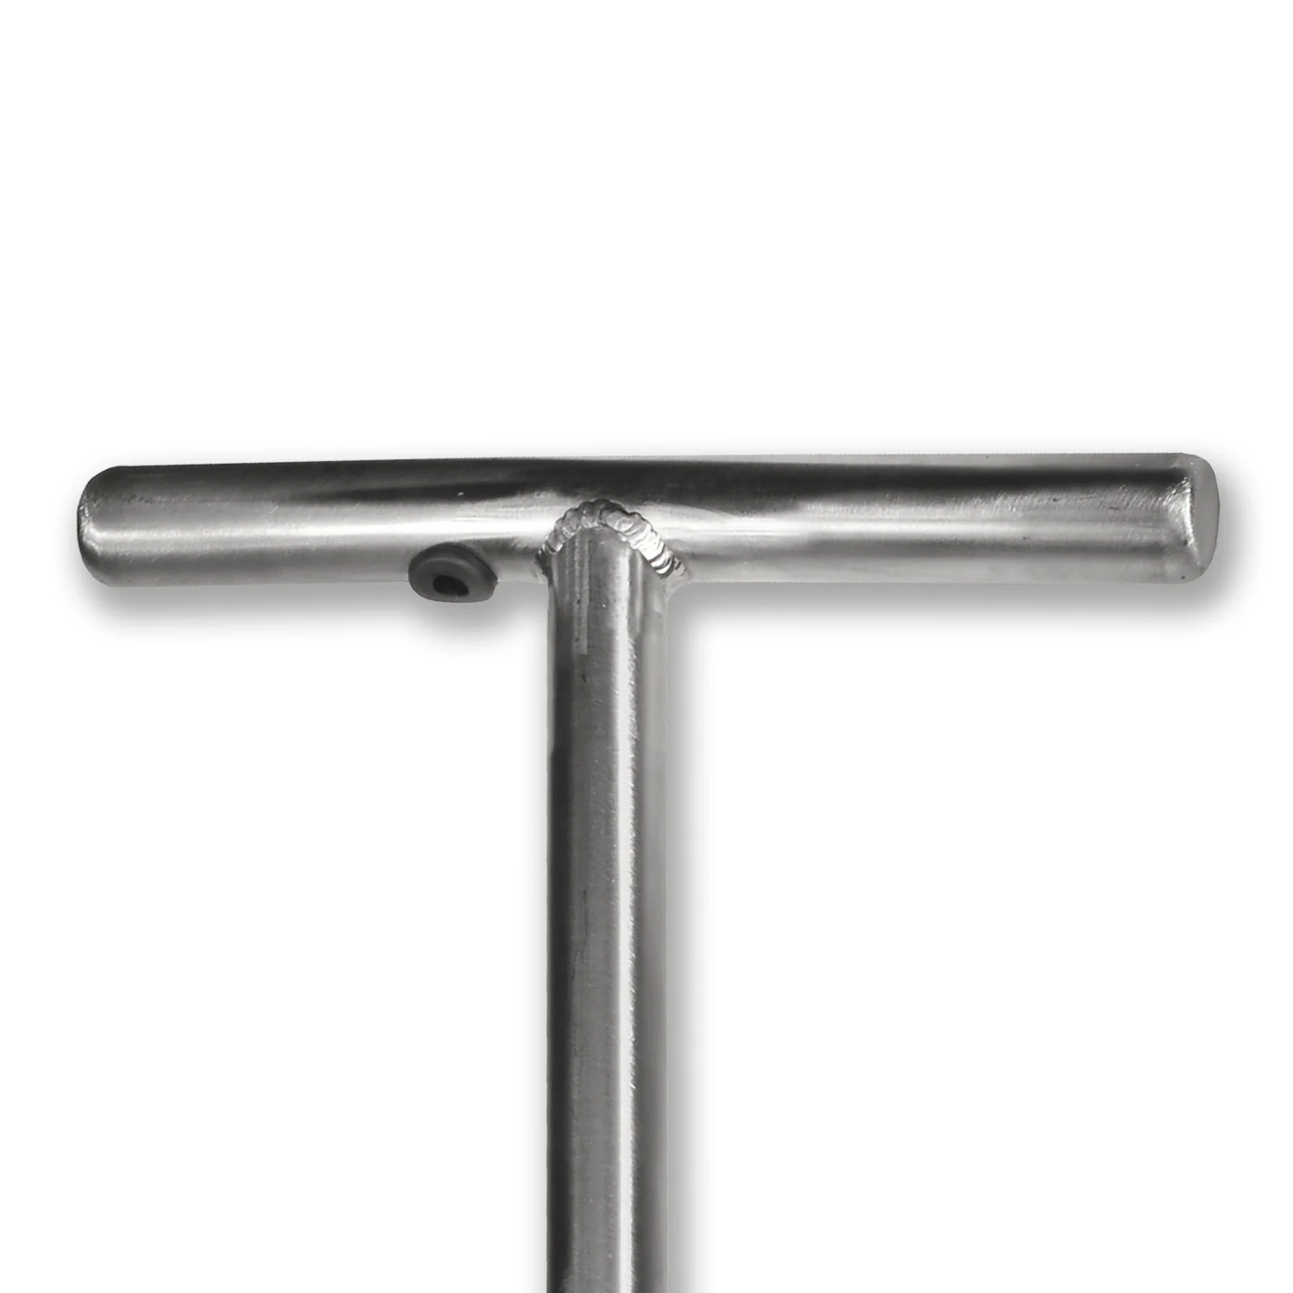
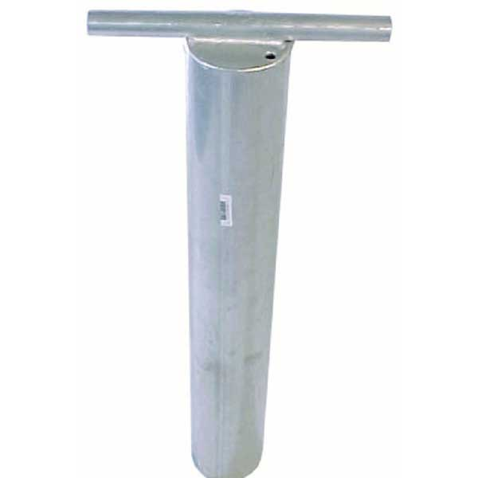
Clam gun
Tilt 10-15 degree toward the ocean
The show should be slightly closer to you while pointing toward the ocean
Push down and slightly wiggle back and forth to help if needed
If your strength allows, the main body of the gun should be all the way into the ground
Press on the air hole on the gun. Need to keep it tight without letting go. Pressure builds up in there.
LOCK your back straight, squat down slightly, and use your LEGS to pull up (not the back).
If you feel like you hit something on the way down, pull up a bit and try to readjust the angle so the clam doesn’t crack.

Slide 12
But the shells! Easiest shellfish shuck of your life
What you need
What you need
Boiling water on stove
Bowl of iced water + ice
That’s it!
Put clam still alive in its shell into boiling water for at most 10s. The longer the clam is “cooked”, the more chewy it gets.
Place the boiled clam into iced water and wait 5-10s.
The clam will now perfectly come off the shell with just normal peeling.
That’s it!

